Slide 1

Mushroom classification
Mirtha, Jason, Eric, Robert
Notes:
je

Slide 2
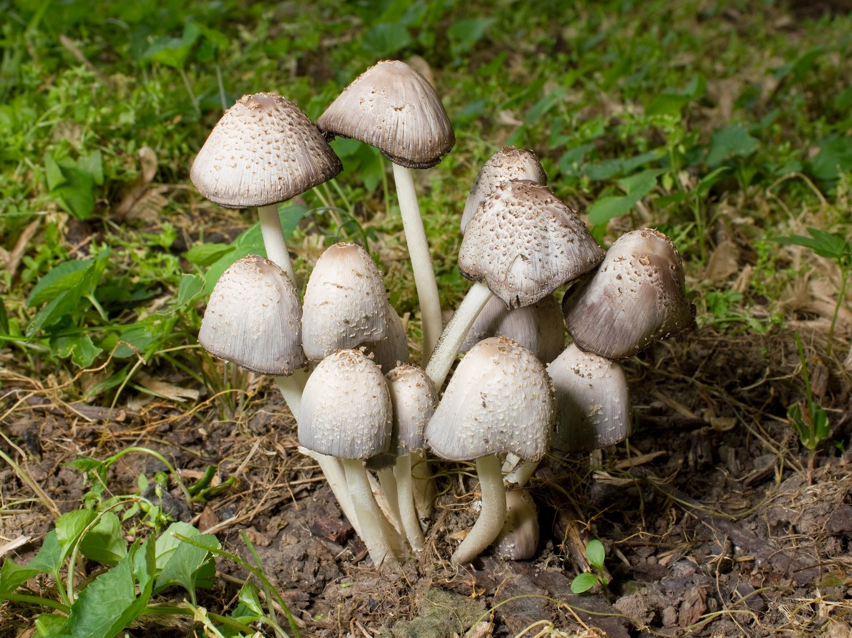
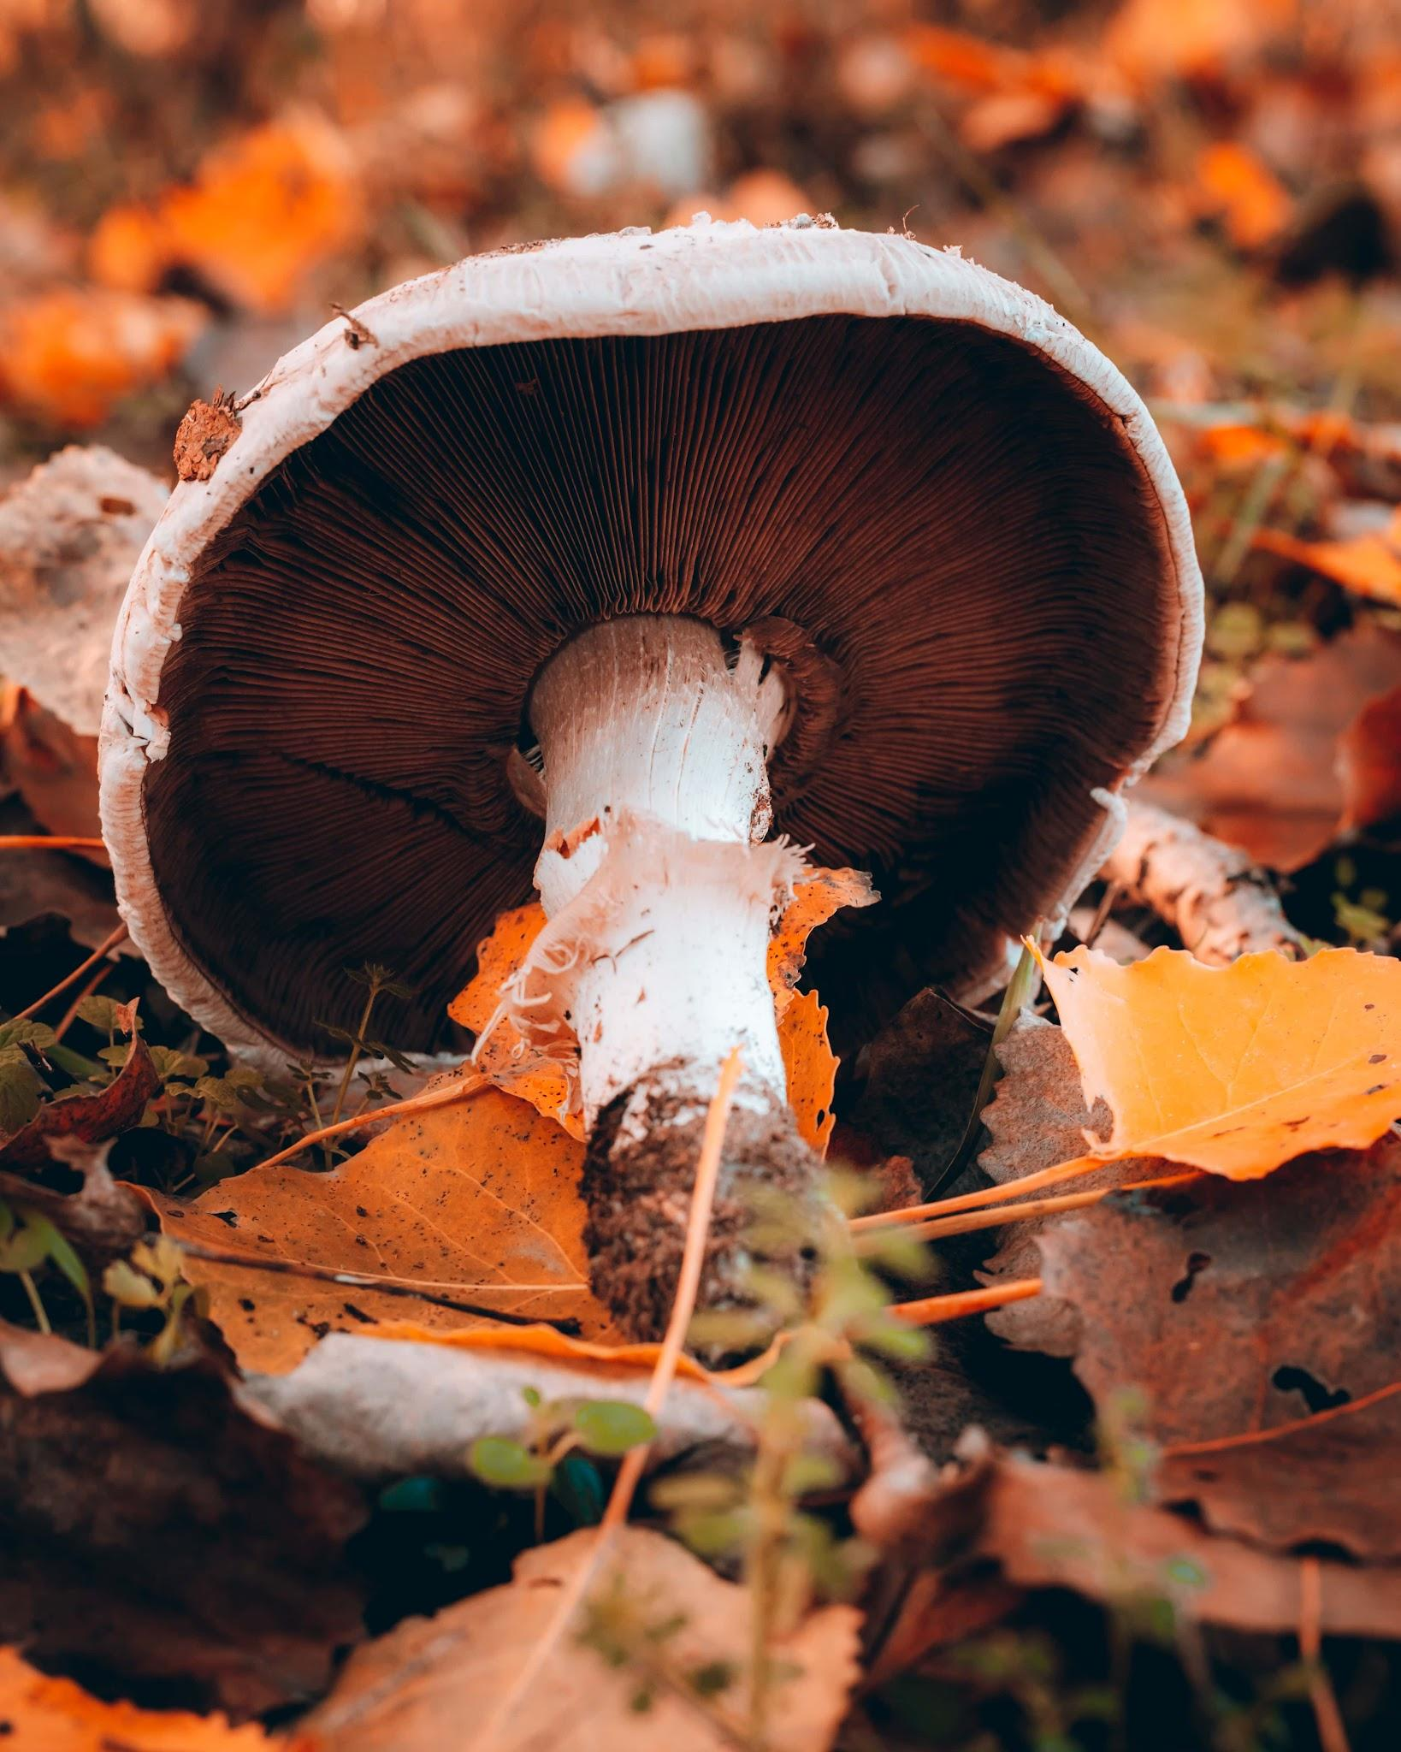
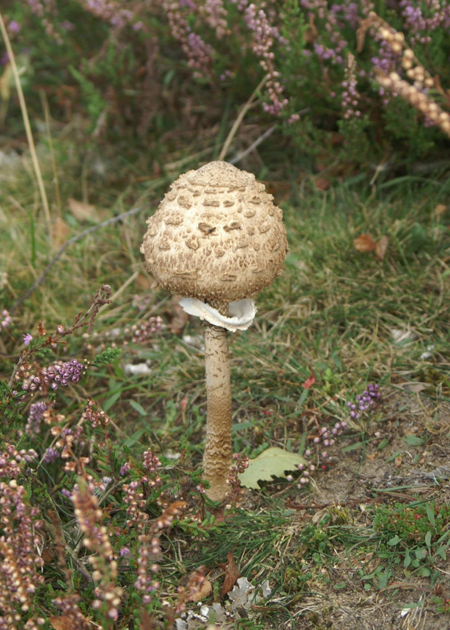
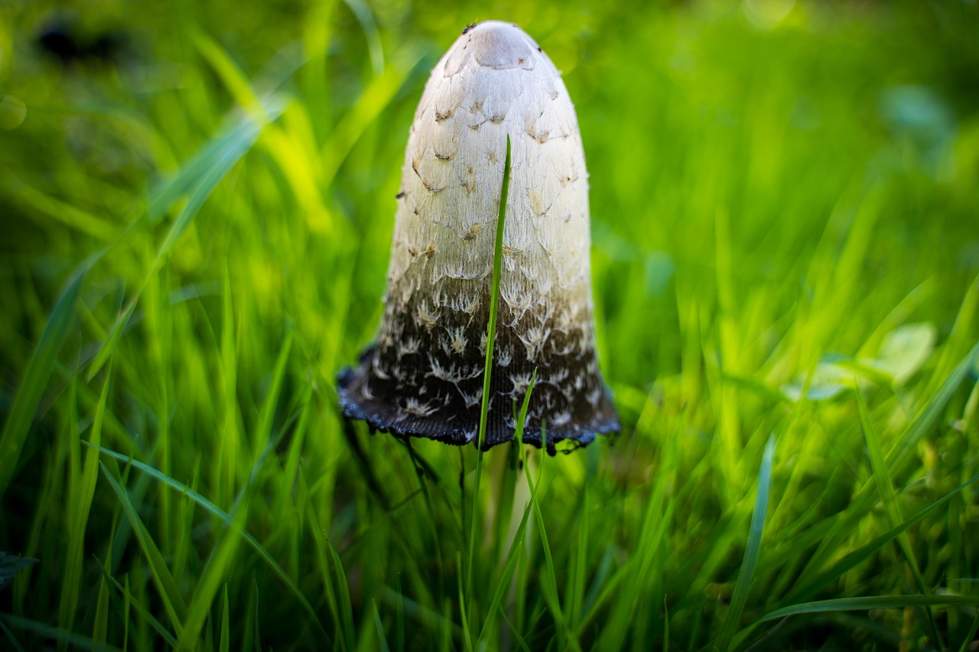
Introduction
Which of the following is edible or poisonous?
Notes:
je

Slide 3
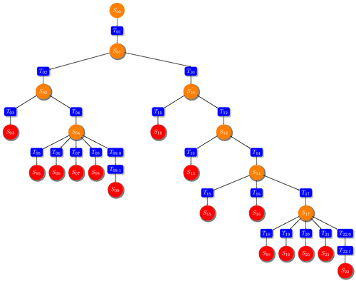
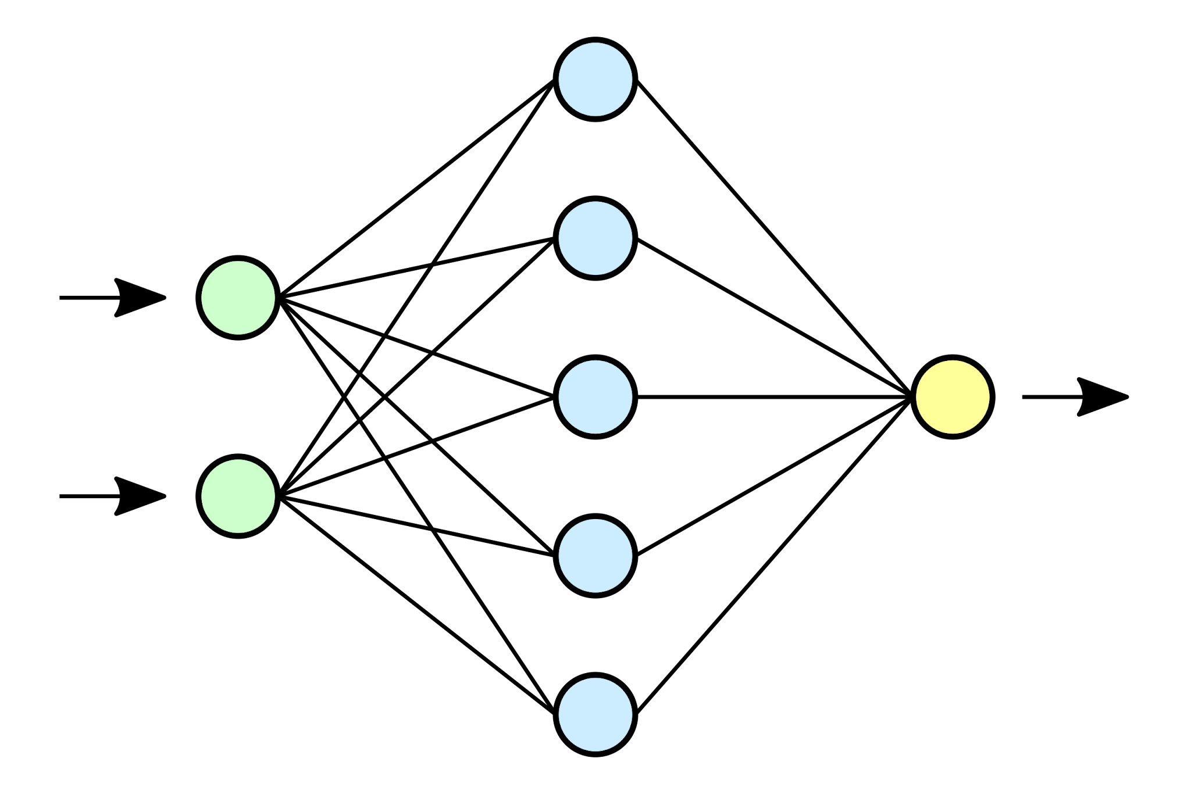

Introduction
Question: Can we predict the edibility of mushrooms based on their features?
What techniques yield the best results?
Notes:
je

Slide 4
Data Description
Made available by the Audubon Society Field Guide
8124 hypothetical mushroom samples are included in the dataset
8124 rows and 23 columns
“Stalk-Root” column was the only one with missing values
All 22 features refer to mushroom attributes such as odor and height
The classification target is an edible/poisonous dichotomy
Notes:
Mirtha

Slide 5
Data processing
Dealing with missing values
Stalk-root had many missing values (we tended to drop that feature)
Veil-type was consistently “p”...not useful
Data splitting
Binned data set
Reduced our variables by grouping them together based on similarities
Ex. white and grey cap color were considered white
AWS was used as our database
Notes:
M & R. binning = grouped by similarity. White and grey became the same variable

Slide 6
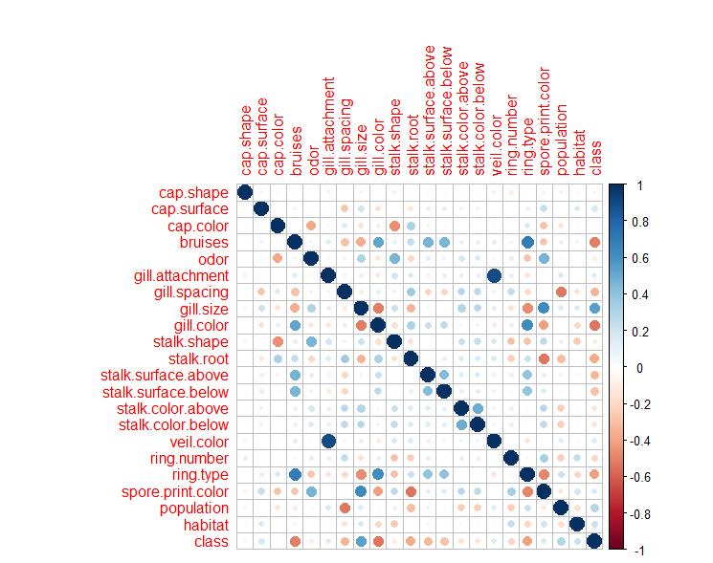
Correlation matrix
We can see that most
Features don’t correlate too highly
with class, nor with other features.
The most highly correlated
features are gill.attachment and
veil.color ( r = .89, p < .05)
Notes:
R

Slide 7
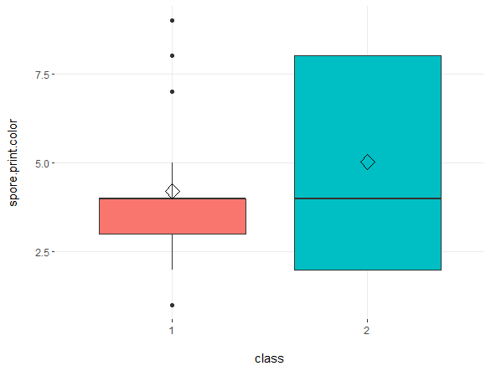
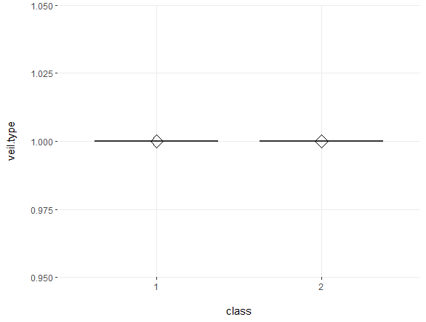
How does the target differ within features?
helpful
Not so helpful

Slide 8
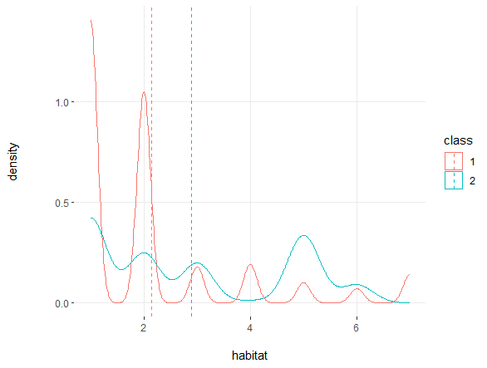
A taste of how the features compare when split by target

Slide 9
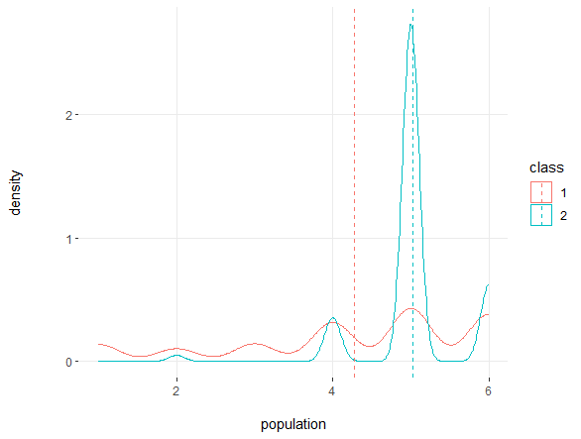
A taste of how the features compare when split by target

Slide 10
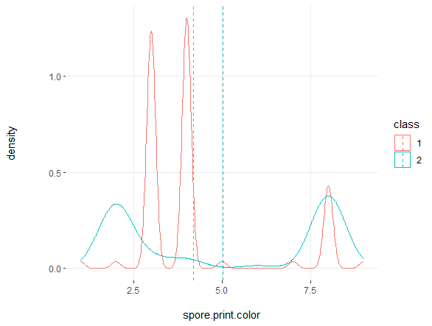
A taste of how the features compare when split by target

Slide 11
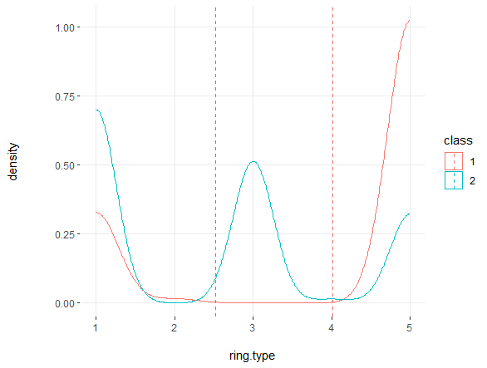
A taste of how the features compare when split by target

Slide 12
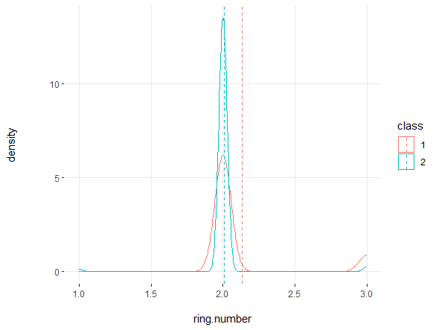
A taste of how the features compare when split by target

Slide 13
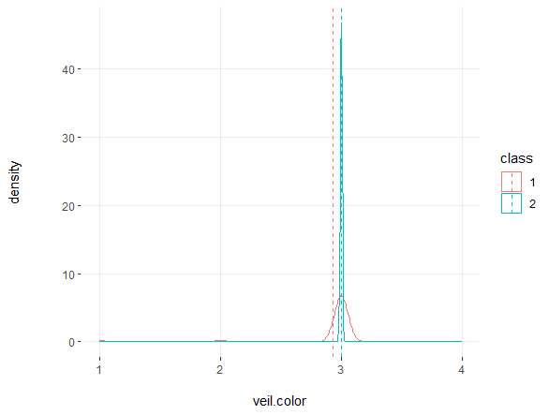
A taste of how the features compare when split by target

Slide 14
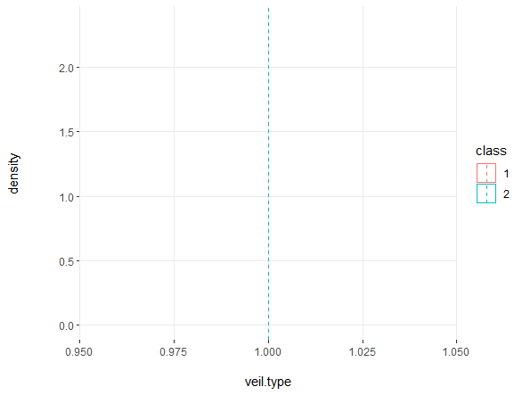
A taste of how the features compare when split by target
:/

Slide 15
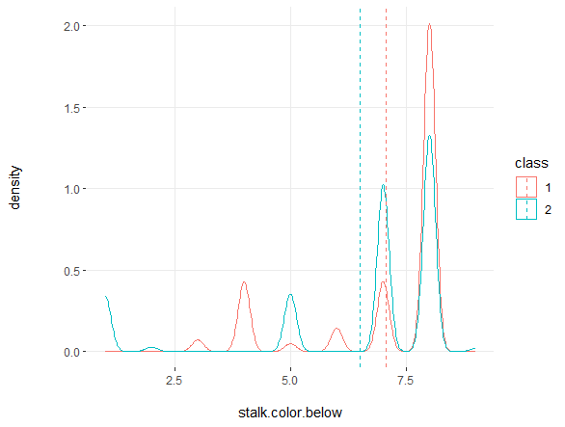
A taste of how the features compare when split by target

Slide 16
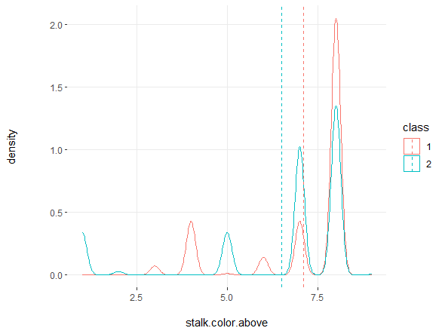
A taste of how the features compare when split by target

Slide 17
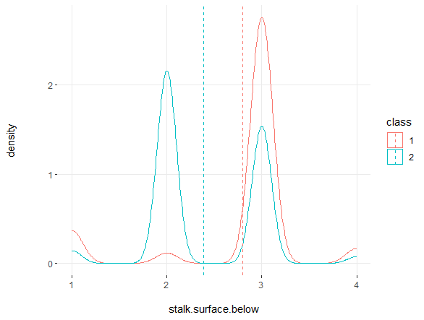
A taste of how the features compare when split by target

Slide 18
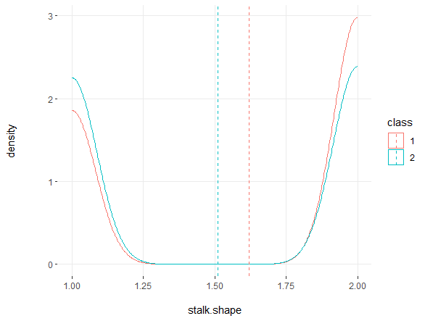
A taste of how the features compare when split by target

Slide 19
Classification Models
Notes:
M

Slide 20
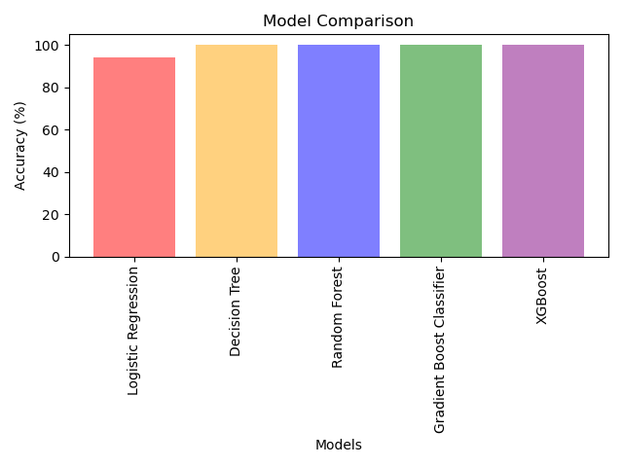
Model comparisons
Model | Accuracy
Logistic Regression | 94%
Decision Tree | 100%
Random Forest | 100%
Gradient Boost | 100%
XGBoost | 100%
Notes:
E

Slide 21
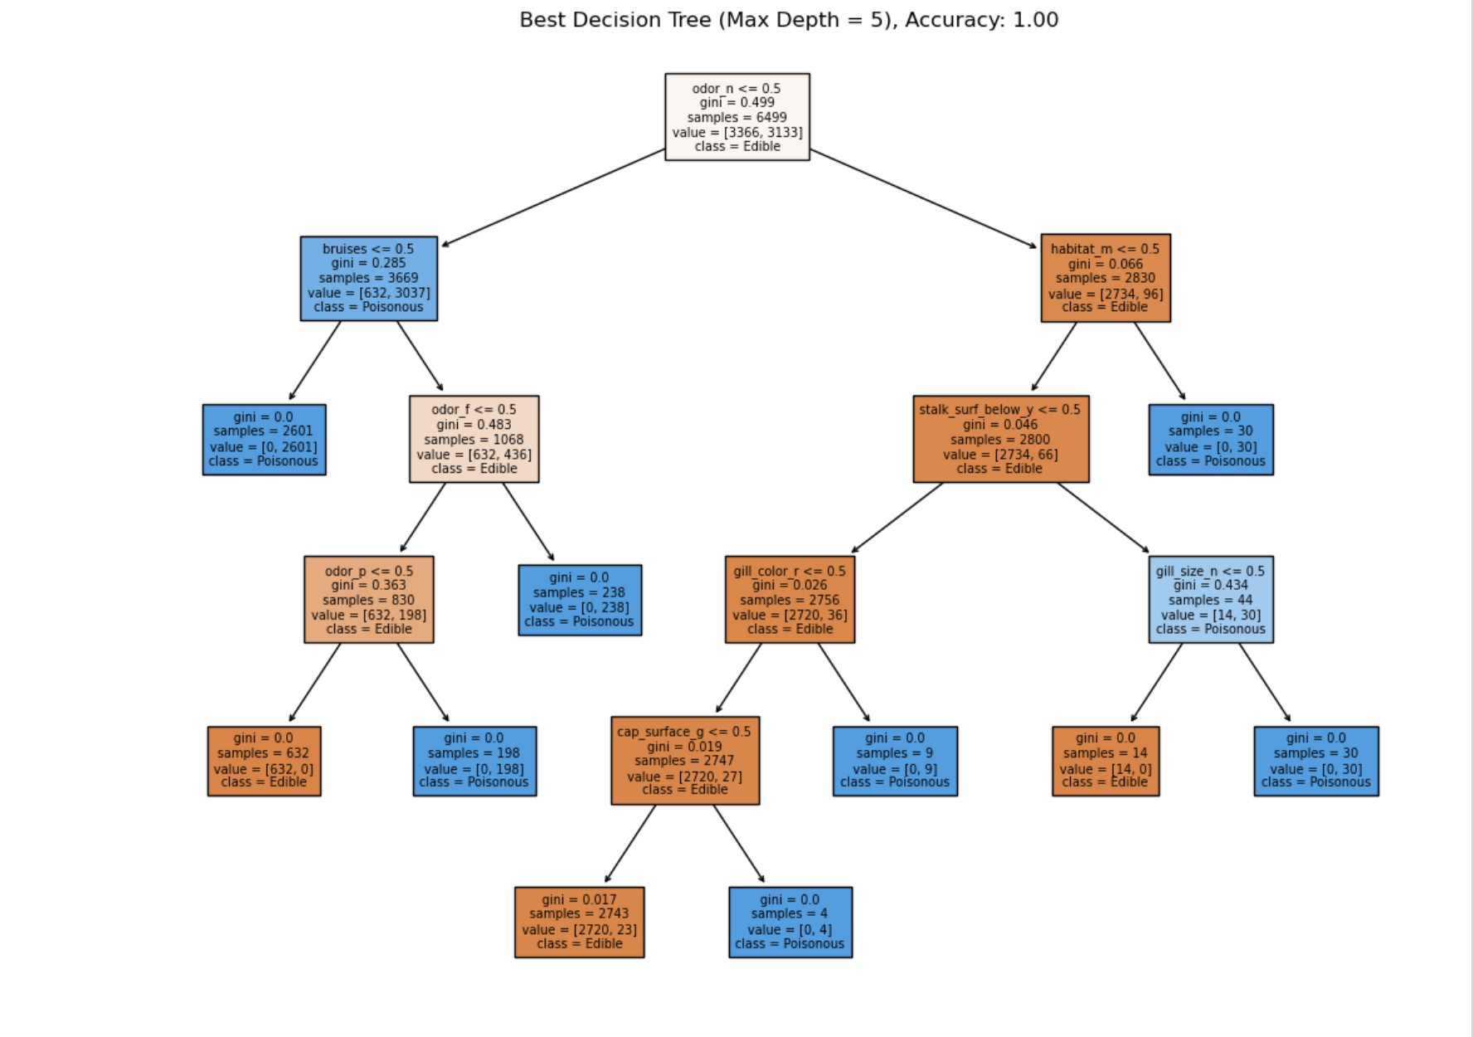
Decision Tree Model
Features such as gill size and color are of least importance
Features such as odor and bruises are of high importance
Notes:
E

Slide 22
Overall Results
Based on our decision tree model, we can conclude the following:
A mushroom that has ANY smell and IT bruises when touched, consider it poisonous
A mushroom the does NOT bruise, but SMELLS foul or pungent, consider it poisonous
These two rules taken together correctly identifies 98.87% of poisonous mushrooms
Notes:
E

Slide 23
What we could have done differently
Figure out how to deal with the missing values rather than drop the entire column
Notes:
E

Slide 24
Questions?
Notes:
E

Slide 25
The End
Notes:
E

